Slide 1
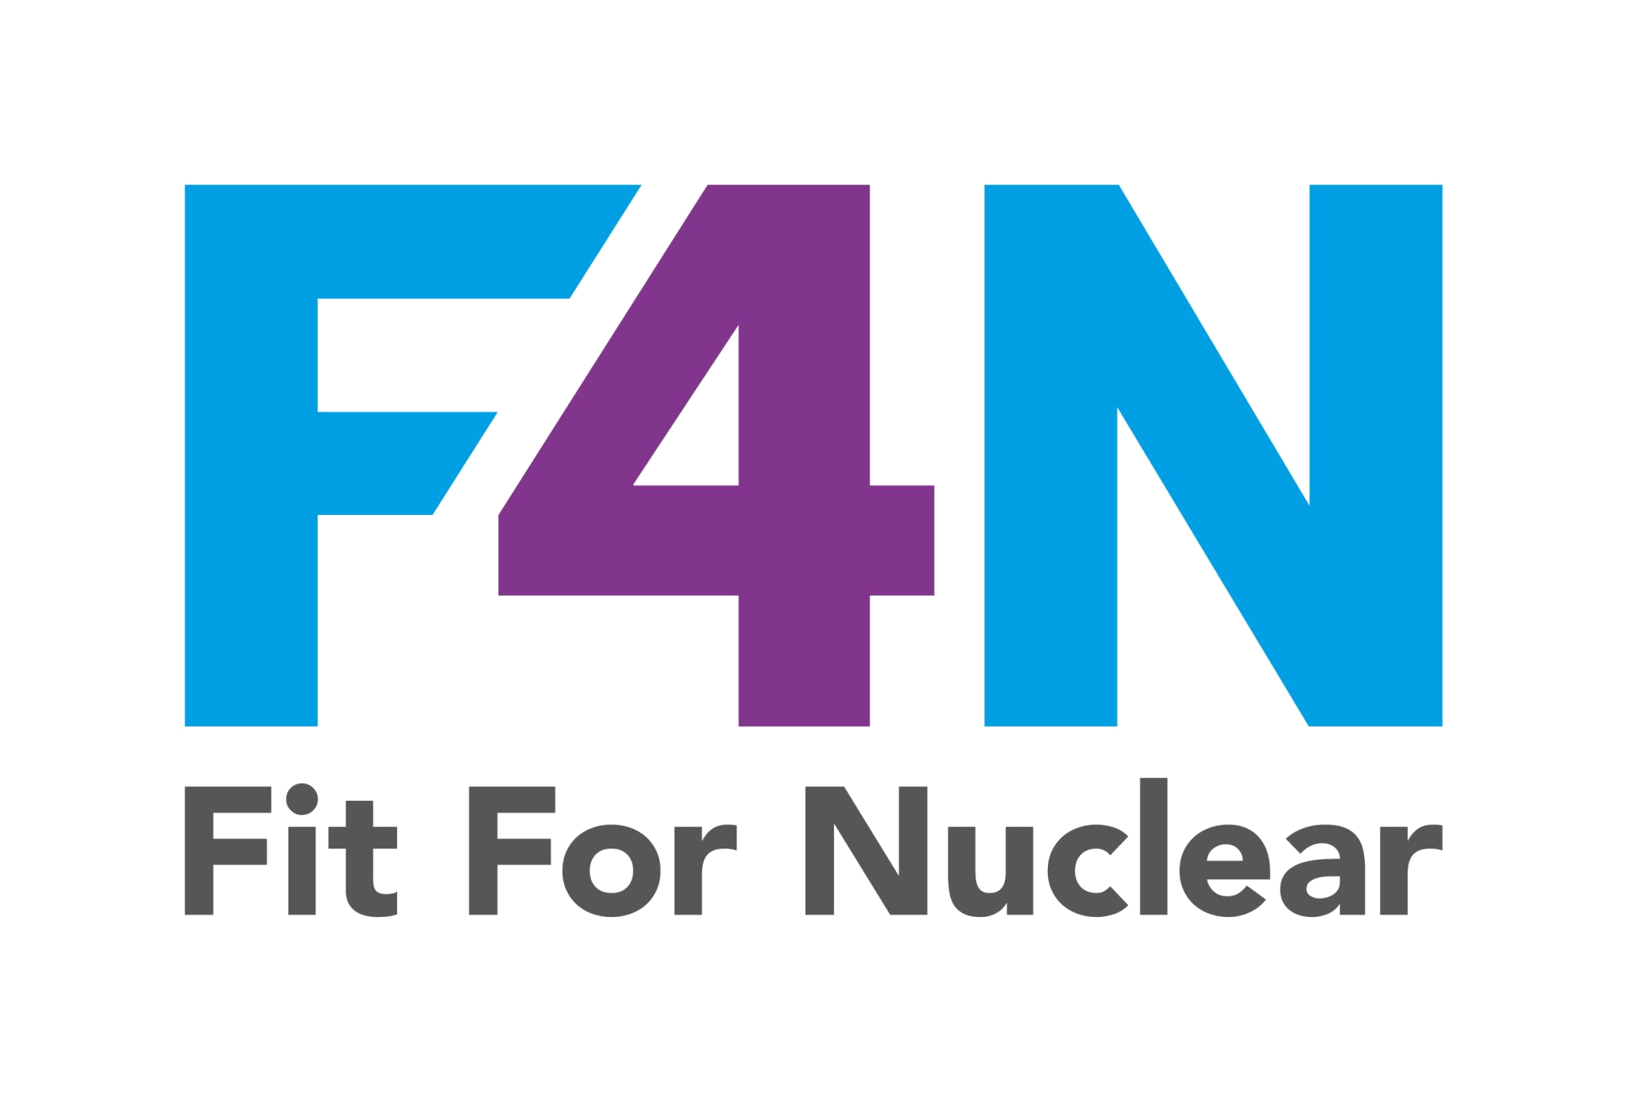

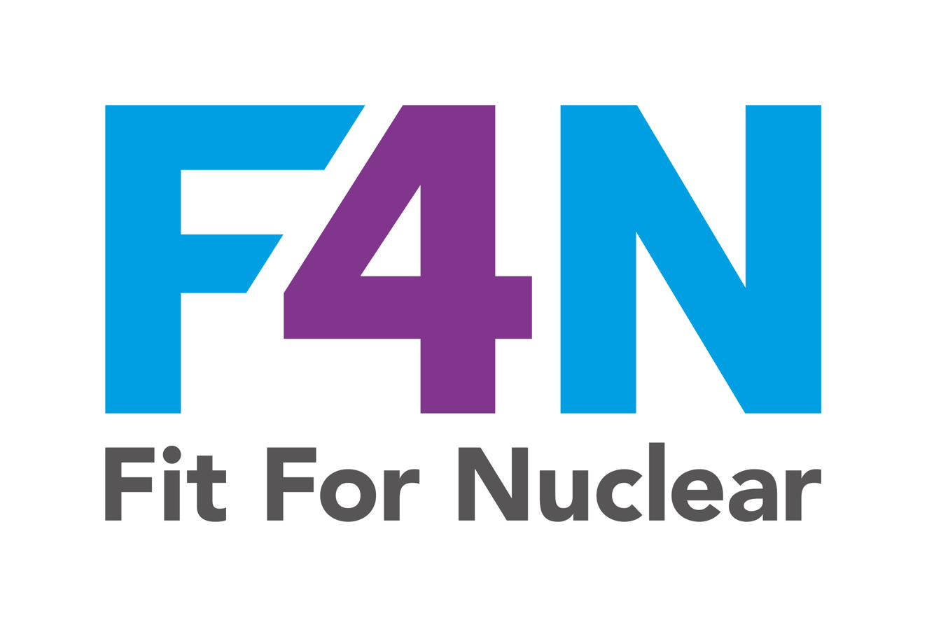
Quality Plans and
Inspection and Test Plans
A Practical Guide for [Company Name] Teams
Commercial in Confidence
NucCol | Nuclear Collaboration Ltd · Fit For Nuclear Programme · Commercial in Confidence | 1

Slide 2
What is a Quality Plan?
A quality plan is a formal document that defines how quality will be managed and demonstrated for a specific contract or project. It is not a general quality manual. It is written for one specific job.
A quality plan must define:
The specific quality objectives for the contract
Which standards and specifications apply
Who is responsible for each quality activity (named SQEP)
How materials will be procured, certified, and traced
What inspections and tests will take place, and at what stages
How non-conformances will be managed
What records must be kept, and how long they will be retained
How changes to scope or specification will be controlled
Nuclear customers expect to receive and formally accept your quality plan before you start work. Starting work without an accepted quality plan is a serious non-conformance.
NucCol | Nuclear Collaboration Ltd · Fit For Nuclear Programme · Commercial in Confidence | 2

Slide 3
Why Do We Need Quality Plans?
Nuclear Safety
Customer Requirement
Traceability
Nuclear components must be made right first time. A failure can have consequences for public safety that last decades.
Nuclear customers require quality plans as a contractual condition. No accepted quality plan = no order.
Nuclear facilities require full traceability of every item for up to 60 years. Quality plans create and maintain that audit trail.
Your Protection
ISO 9001 / ISO 19443
Winning More Work
A well-run quality plan protects your company by demonstrating that you followed agreed processes if a dispute arises.
Quality planning is a requirement of ISO 9001 clause 8.1 and is central to ISO 19443 for nuclear supply chains.
Companies that can demonstrate quality plan experience and capability are more attractive to nuclear Tier 1 contractors.
NucCol | Nuclear Collaboration Ltd · Fit For Nuclear Programme · Commercial in Confidence | 3

Slide 4
The Quality Plan Lifecycle
1
2
3
4
Contract Award
Draft QP + ITP
Internal Approval
Submit to Customer
Quality Manager reviews PO / contract requirements and triggers quality planning
Quality plan and ITP prepared using company templates. All sections completed.
Reviewed by Contract Manager. Comments resolved. Approved.
Submitted for customer acceptance. Work cannot start until accepted.
5
6
7
8
Opening Meeting
Execute
Final Inspection
Close
Requirements confirmed. Hold/witness point notice periods agreed.
ITP activities carried out. Hold points signed off. NCRs raised and managed.
All ITP activities complete. LQR assembled and reviewed.
CoC issued. LQR submitted to customer. Lessons learned recorded.
NucCol | Nuclear Collaboration Ltd · Fit For Nuclear Programme · Commercial in Confidence | 4

Slide 5
What is an Inspection and Test Plan (ITP)?
The ITP is the activity-by-activity inspection roadmap for a specific contract. It translates the quality plan into a sequence of inspection and test actions that prove each requirement has been met.
For each activity the ITP defines:
The activity and its reference number
The phase (pre-production, manufacture, final inspection, delivery)
Who carries out the activity (manufacturer, company inspector, customer)
The type of activity (Hold Point, Witness Point, Review, Surveillance)
The method or procedure reference
The acceptance criteria reference
What record must be produced
Where the inspector and customer must sign off
The ITP is a live document. It should be updated in real time as activities are completed and signed off. The completed ITP becomes part of the Lifetime Quality Record submitted to the customer.
NucCol | Nuclear Collaboration Ltd · Fit For Nuclear Programme · Commercial in Confidence | 5

Slide 6
Hold Points and Witness Points
HOLD POINT
WITNESS POINT
Work MUST STOP.
Work cannot proceed past this point until:
The designated inspector has been present
The activity has been completed and signed off
The customer QR has also signed off (where specified)
Minimum 5 working days notice required
Customer notified. They may attend.
Process:
Send written notice at least 5 working days before
If customer attends: sign off required
If customer does not attend after notice: work may proceed
All notifications and responses MUST be documented
REVIEW (R)
SURVEILLANCE (S)
NEVER proceed past a Hold Point without proper sign-off. This is one of the most serious failures in nuclear supply chain quality management.
Document check. Inspector reviews records only.
Random oversight. Inspector may attend without notice.
NucCol | Nuclear Collaboration Ltd · Fit For Nuclear Programme · Commercial in Confidence | 6

Slide 7
Nuclear Safety Classification and Quality Grading
The depth of your quality plan and the level of inspection required depends on the nuclear safety classification of the items you are supplying. Customers set this classification based on the safety significance of the item in the nuclear facility.
Classification
Safety Significance
Inspection Requirements
Typical Examples
QC1
Highest safety significance. Failure could cause uncontrolled radioactive release.
100% witnessing, inspection, and document review. Full LQR. Type 3.2 material certs.
Nuclear pressure vessels, primary circuit components, safety system actuators
QC2
High significance. Failure could cause serious radiological hazard.
50% witnessing and inspection. 100% document review. Full LQR. Type 3.1 certs.
Secondary circuit components, lifting equipment over reactors, large pressurised systems
QC3
Moderate significance. Failure could reduce plant integrity.
10% witnessing. Document review. Key records. Type 2.2 certs.
Auxiliary systems, general structural steelwork, non-safety electrical systems
QC4
Low significance. Certificate of conformity required.
Certificate of conformity only. Standard commercial controls.
General consumables, non-safety fixings, commercial off-the-shelf (COTS) items
NucCol | Nuclear Collaboration Ltd · Fit For Nuclear Programme · Commercial in Confidence | 7

Slide 8
Materials and Traceability
In the nuclear supply chain, every material must be fully traceable from the raw material source through to the finished product. This is not optional: it is a fundamental requirement.
What traceability means in practice:
Material certificates must be obtained BEFORE materials are used, not after.
Certificates must be verified against the specification (correct grade, heat number, mechanical and chemical properties).
A material traceability matrix must be maintained: linking each certificate to the specific items it covers.
Heat or batch numbers must be marked on materials and maintained throughout manufacture.
Where materials are cut or processed, the traceability link to the original certificate must be maintained.
Final Lifetime Quality Records must show the complete chain from certificate to finished item.
CFSI AWARENESS: Counterfeit, Fraudulent, and Suspect Items (CFSI) are a real risk in the nuclear supply chain. Every item must be inspected at goods receipt. If anything looks wrong - packaging, markings, pricing significantly below market - quarantine the item and notify the Quality Manager immediately. Never use a suspect item.
NucCol | Nuclear Collaboration Ltd · Fit For Nuclear Programme · Commercial in Confidence | 8

Slide 9
Non-Conformance Management
A non-conformance occurs whenever a product, material, service, or activity does not meet the specified requirements. Managing non-conformances correctly is essential: how you handle them is as important as avoiding them.
The NCR process:
1. IDENTIFY
2. STOP
3. RAISE NCR
4. NOTIFY QM
5. ASSESS
6. CLOSE
Non-conformance found by inspector or operative
Segregate and tag the non-conforming item. Stop work in affected area.
Complete an NCR form. Record what was found, where, and when.
Inform the Quality Manager. Customer notified within 24 hours for QC1/QC2.
Quality Manager assesses root cause and proposes disposition.
Disposition agreed and implemented. Corrective action tracked to closure.
Immediately
Immediately
Within 1 hour
Within 2 hours
Within 1 working day
Per agreed timescale
NCRs are not a sign of failure. They are a sign of a healthy quality system. Covering up a non-conformance is far more serious than raising one.
NucCol | Nuclear Collaboration Ltd · Fit For Nuclear Programme · Commercial in Confidence | 9

Slide 10
Lifetime Quality Records (LQR)
The Lifetime Quality Record is the complete package of documented evidence that the supplied items meet all specified requirements. It is submitted to the customer and may be retained for up to 60 years.
Typical LQR contents:
Quality Plan (signed and customer-accepted copy)
Completed and signed Inspection and Test Plan
Material certificates (to specified EN 10204 level)
Weld maps, weld records, and WPS / WPQR
NDT reports (signed by qualified Level 2 / Level 3)
Dimensional inspection reports
Heat treatment charts and certificates (if applicable)
Calibration records for measuring equipment used
NCR log (all items closed or subject to approved concession)
Certificate of Conformity (signed by Quality Manager)
BUILD THE LQR AS YOU GO. Do not wait until the end. Each inspection activity in the ITP generates a record. Compile the LQR concurrently so there are no gaps at contract close.
Retain a copy of the complete LQR for a minimum of 10 years (or as specified in the contract).
NucCol | Nuclear Collaboration Ltd · Fit For Nuclear Programme · Commercial in Confidence | 10

Slide 11
Your Quality Planning Toolkit
These documents work together as a coordinated system. Use them for every contract that requires a quality plan.
QHSE-QP-01
Contract Quality Plan Template
Complete this for every contract. Submit to the customer for acceptance before starting work.
QHSE-QP-02
Inspection and Test Plan (ITP)
The activity-by-activity inspection roadmap. Prepared alongside the quality plan. Updated in real time during execution.
QHSE-QP-03
Quality Plan Register and Status Tracker
Central register of all live quality plans. Includes hold point tracker, document submission log, and lessons learned.
QHSE-QP-04
Quality Planning Process Guide
Step-by-step guide to the quality planning process. Read this first if you are new to quality planning.
NucCol | Nuclear Collaboration Ltd · Fit For Nuclear Programme · Commercial in Confidence | 11

Slide 12
Key Reminders
1
Never start work without an accepted quality plan and ITP.
2
Never proceed past a Hold Point without proper sign-off from the inspector and, where required, the customer.
3
Raise an NCR immediately when a non-conformance is found. Do not hide it or work around it.
4
Verify material certificates against the specification BEFORE the material is used.
5
Inspect every incoming delivery for CFSI signs. Quarantine suspect items immediately.
6
Build the Lifetime Quality Record as you go. Do not leave it to the end of the contract.
7
All changes to scope, drawings, or specifications must go through formal change control before implementation.
8
If you are unsure about any quality requirement, stop and ask the Quality Manager. Never guess.
NucCol | Nuclear Collaboration Ltd · Fit For Nuclear Programme · Commercial in Confidence | 12

Slide 13
Quality Plans and ITPs
The foundation of your nuclear supply chain quality assurance.
Any questions? Contact your Quality Manager.
Commercial in Confidence | [Company Name] | [Date]
NucCol | Nuclear Collaboration Ltd · Fit For Nuclear Programme · Commercial in Confidence | 13

